Slide 1
Past perfect

Slide 2
Past perfect
Structure:
(+) Subj. + Aux. Verb (Had)+ Main Verb (Past Participle)
(-) Subj. + Aux. Verb (Had)+ “Not” + Main Verb (Past Participle)
(?) Aux. Verb (Had)+ Subj. + Main Verb (Past Participle) + “?”

Slide 3
Past perfect
Structure:
(+) I + Had + Done +(The thing)
(-) I + Had + Not + Done +(The thing)
(?) Had + I + Done +(The thing) + ?

Slide 4
Past perfect
Uses:
To talk about actions that happened before the past
Finished actions
Not Finished Actions

Slide 5
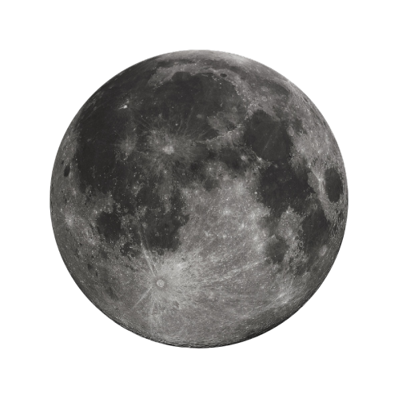



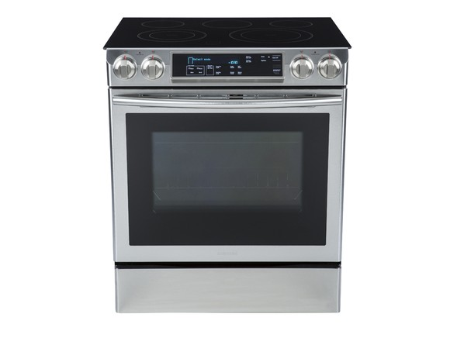
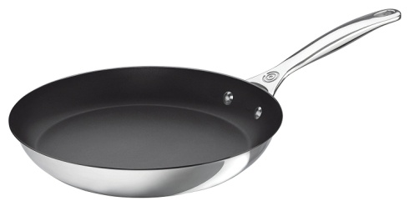
Past perfect
Finished actions:
Did you made the cake you told me about?
Yes, I had made the cake before I started preparing supper.

Slide 6
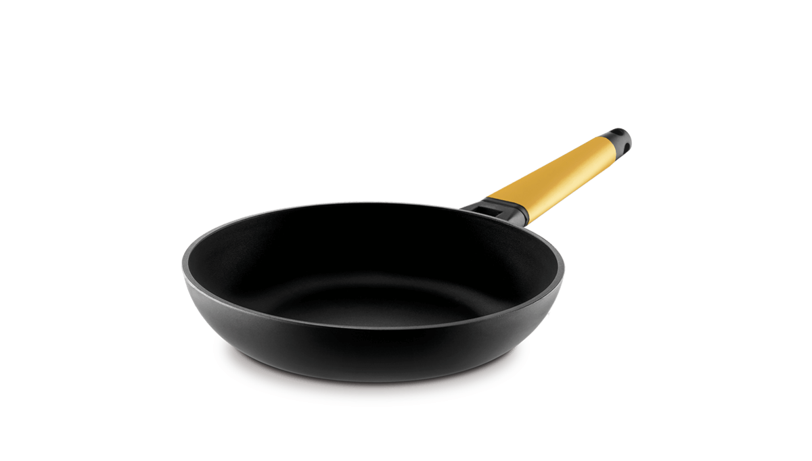
Past perfect
Not finished actions:
Did you made the cake you told me about?
No, had started making the cake before I started making the supper, but it is not ready yet

Slide 7
Past perfect
Uses:
To talk about actions that happened before the past
Finished actions
Not Finished Actions
Possible Complements:
Time
Place
Tools
Way

